Slide 1
Economic Evaluation of Infectious Disease Interventions
Jeehyun Lee
School of Mathematics and Computing
Yonsei University

Slide 2
Topics
Introduction to Economic Evaluation of Infectious Disease Interventions
Types of Economic Evaluation
Cost-Effectiveness Analysis
Cost-Benefit Analysis
Models of Infectious Diseases
Static models: Decision tree / Markov model
Dynamic models: Compartmental model / ABM
Examples

Slide 3
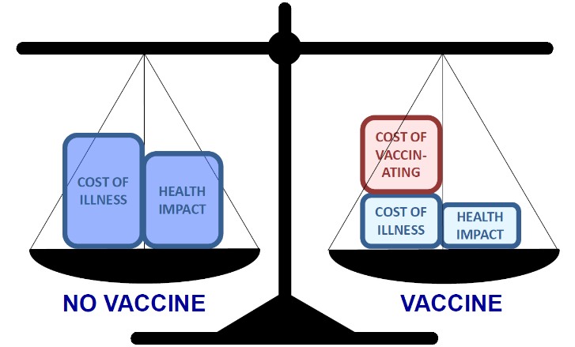
Economic Evaluations
The goal is to ensure that resource
allocation decisions are made on explicit,
evidence-based and needs-based criteria
Systemic assessment of effects and/or impacts of health technologies and interventions
Compares the incremental costs and consequences of an intervention compared to a comparator
Inform policy makers how to allocate the limited resources to health interventions

Slide 4
Types of Economic Evaluation
Type of analysis | Key question | Key assumption
Cost-minimization | How much does B cost compared to A financially? | A and B have equivalent health benefits, so we should pick the cheapest.
Cost-effectiveness (Cost-utility) | How much does B cost compared to A per case of flu prevented? | We know how much we want to spend to prevent a flu case.
 | How much does B cost compared to A per QALY* gained? | We know how much we want to spend to gain a QALY.
Cost-benefit | What is the benefit vs cost ratio of B compared to A? | We want to allocate our spending based on relative willingness to pay.
QALY*: quality-adjusted life year

Slide 5
Cost-Effectiveness Analysis
Costs of vaccines
Travel costs to clinics
Loss of productivity
ICER = Incremental cost-effectiveness ratio
Incremental costs
=
=
Intervention costs
Incremental health gains
Economic
Burden
-
Economic
burden
Cases of disease prevented
Life years gained
QALYs gained
DALYs averted
Health
Gains
Health
Gains
-
Intervention
No Intervention

Slide 6
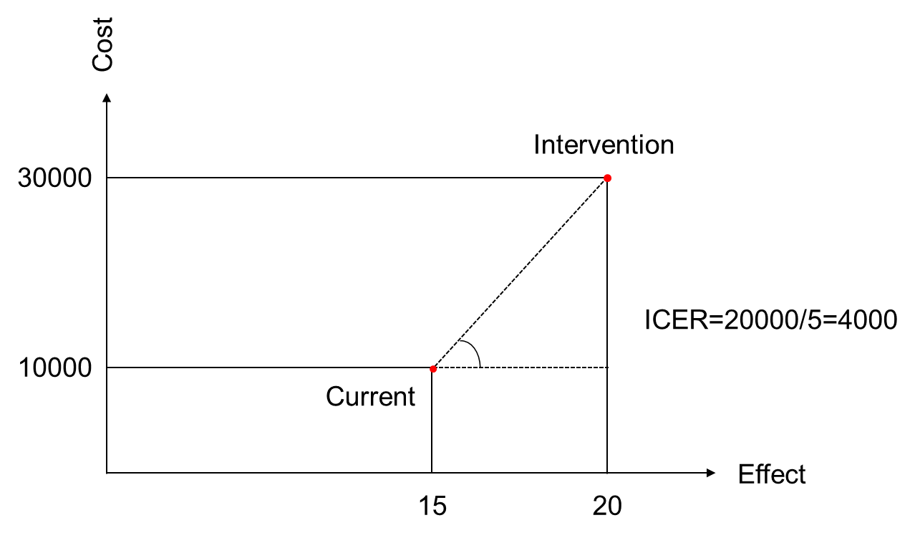
Incremental Cost-Effectiveness Ratio

Slide 7
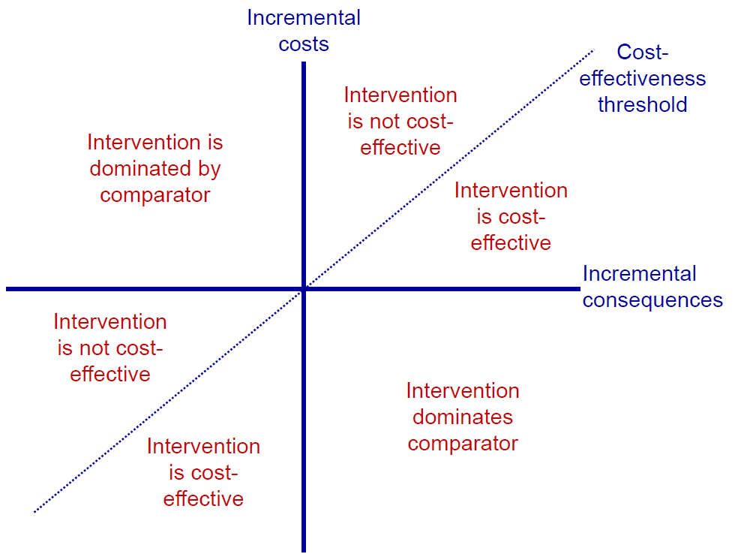
Cost-Effectiveness Plane

Slide 8
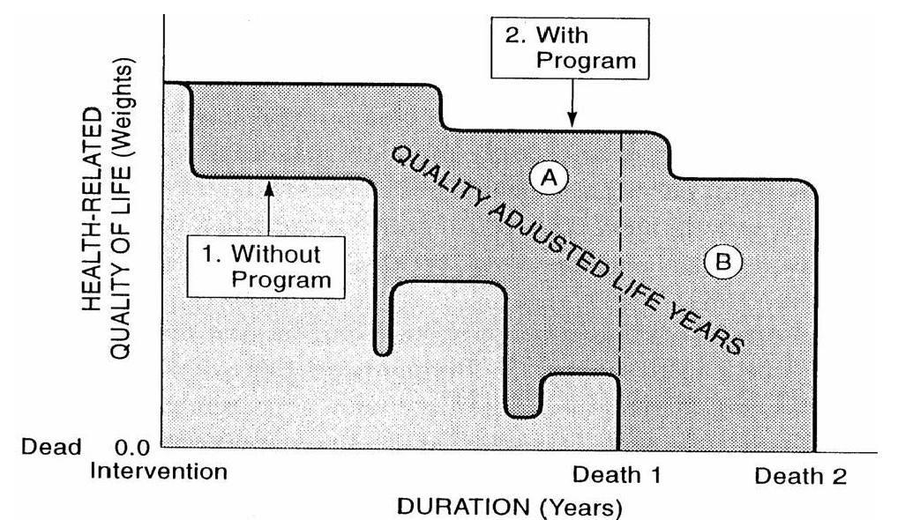
Measuring Benefits: QALYs

Slide 9
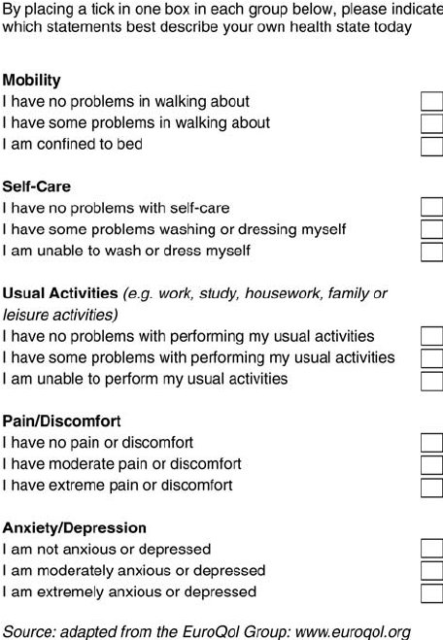
Generic Instruments to Measure QALYs

Slide 10
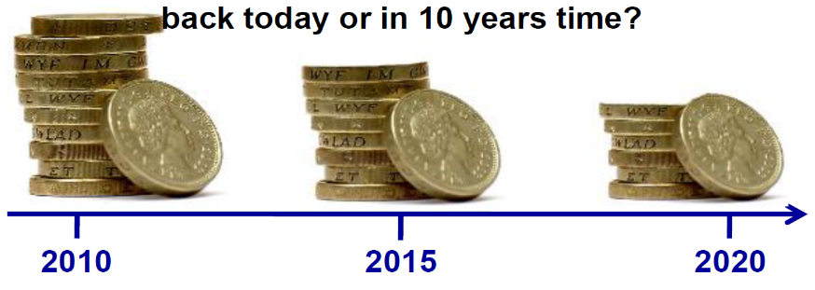
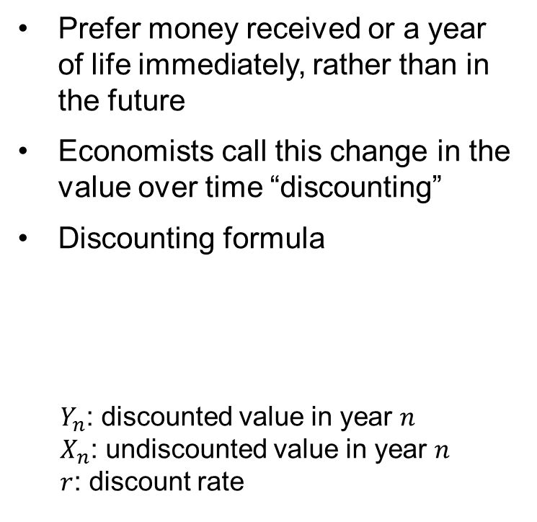
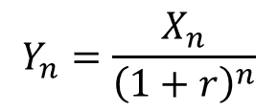
Discounting
Prefer money received or a year of life immediately, rather than in the future
Economists call this change in the value over time “discounting”
Discounting formula
$Y_{n}$: discounted value in year $n$
$X_{n}$: undiscounted value in year $n$
$r$: discount rate
Country | Discount rate: costs | Discount rate: effects
Mexico | 5% | 5%
Netherlands | 4% | 1.5%
Thailand | 3% | 3%
South Africa | 5% | 5%
UK | 3.5% | 3.5%
USA | Unofficially 3% | Unofficially 3%
$$Y_{n}=\frac{X_{n}}{{\left(1+r\right)}^{n}}$$

Slide 11
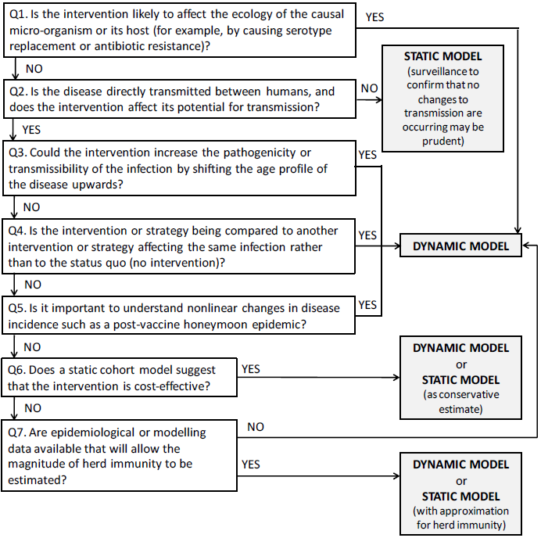
Model Choice for Diseases
WHO guide for standardization of economic evaluations of immunization program
Jit and Brisson. Pharmacoeconomics 2011

Slide 12
Model Choice for Infectious Diseases
Interventions may have complex interactions with the pathogen and with host immunity.
Pathogen-host interactions
Beneficial or detrimental impact on individuals not receiving the intervention (herd immunity).
Ecological externalities
Interventions may have long-term implications (eradication, accumulation of susceptible).
Time horizon
Epidemic (cholera) or emerging (pandemic flu) infections have a wide macroeconomic impact.
Economic scope

Slide 13
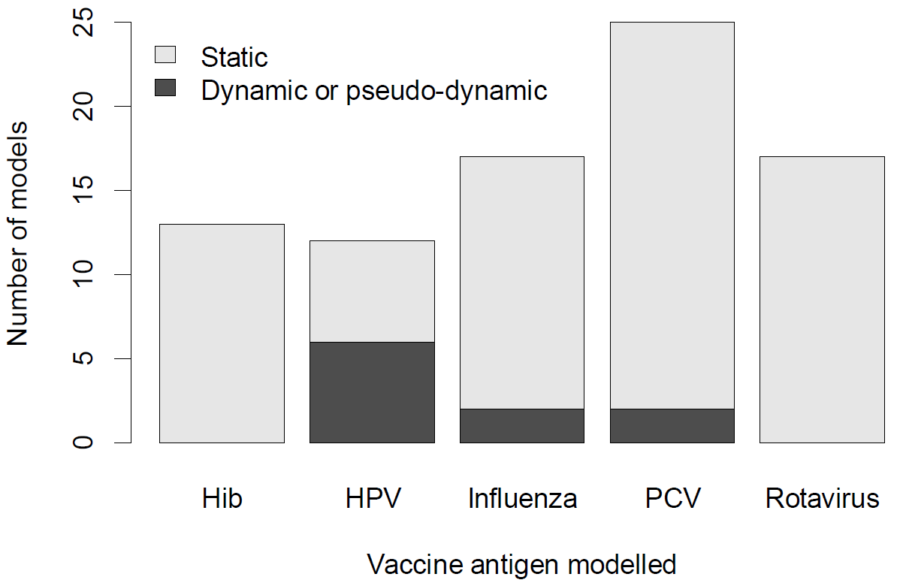
Economic Models of Vaccination in the Literature

Slide 14
Decision Tree
Protected
Vaccination
Infected
Not protected
Not infected
Infected
No vaccination
Decision node
Not infected
Chance node
Terminal node

Slide 15
Markov Model
Current state
 | Healthy | Sick | Death
Healthy | 0.9 | 0.2 | 0
Sick | 0.1 | 0.6 | 0
Death | 0 | 0.2 | 1
Next state
Death
Healthy
Sick

Slide 16
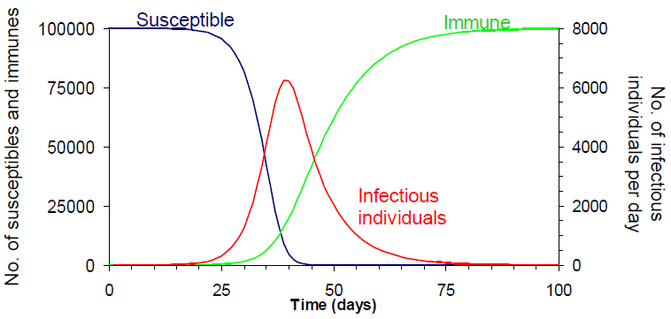
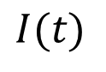
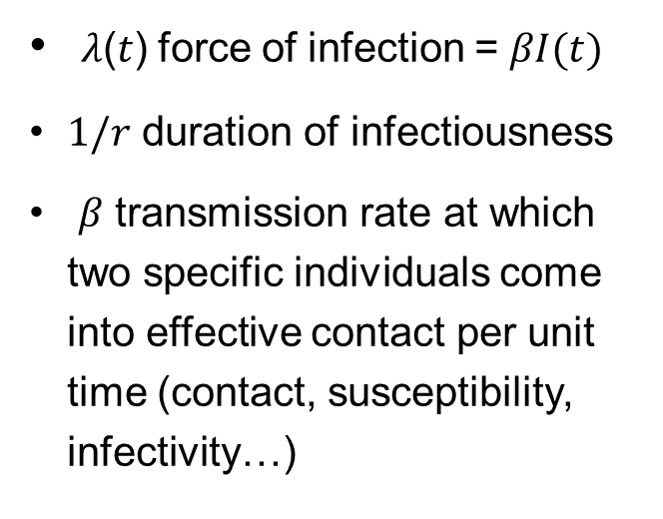
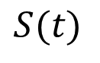
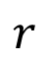
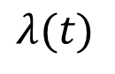
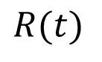
Compartmental Model
$$λ(t)$$
$$r$$
$$S(t)$$
$$I(t)$$
$$R(t)$$
𝜆(𝑡) force of infection = $βI(t)$
$1/r$ duration of infectiousness
𝛽 transmission rate at which two specific individuals come into effective contact per unit time (contact, susceptibility, infectivity…)

Slide 17
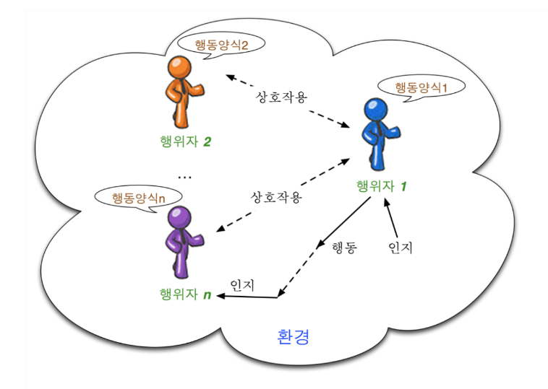
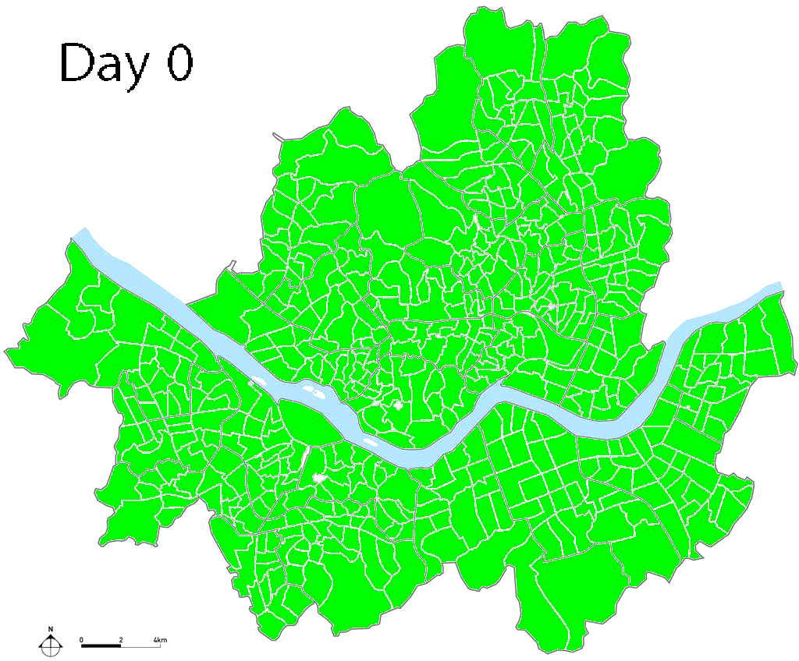
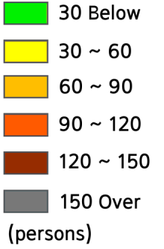
Agent Based Model
Influenza simulation in Seoul

Slide 18
Examples: Study Framework
Dynamic Compartmental Model
Model parameters Initial values
Incidence
Prevalence
CEA
CBA
Cost & Effect
Cost & Benefit
ICER
IBCR

Slide 19
CEA of PrEP for the Prevention of HIV

Slide 20
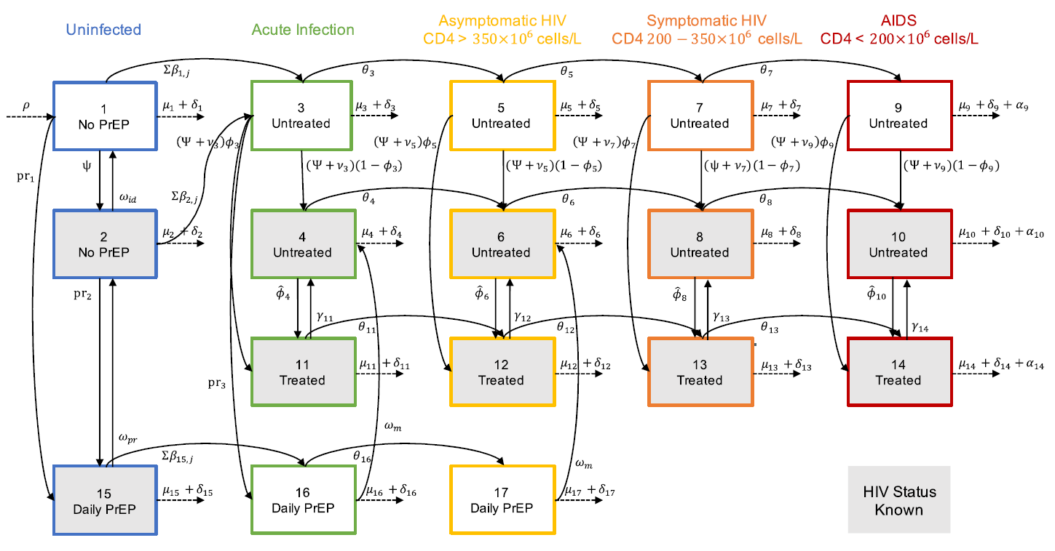
HIV Infection Model for MSM

Slide 21
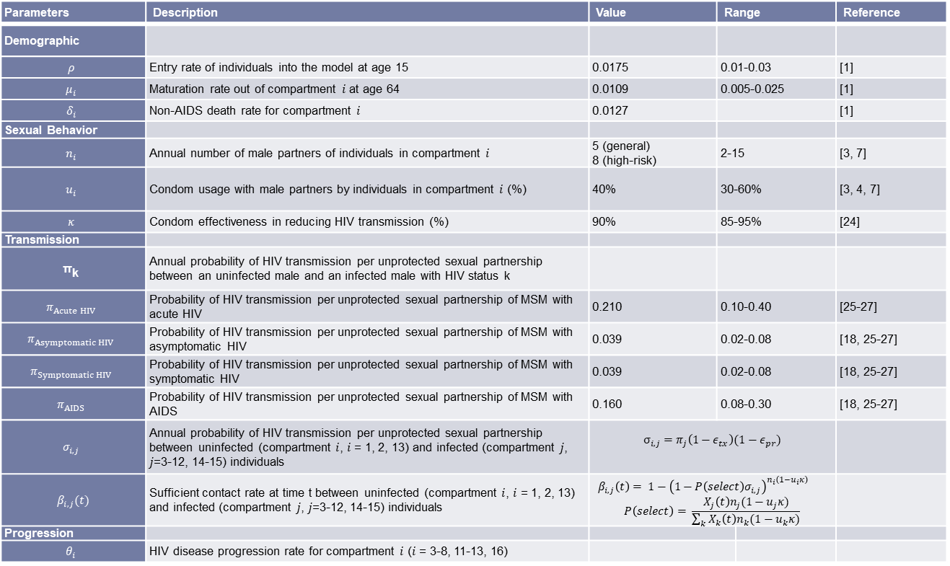
Model Parameters
Parameters | Description | Value | Range |  | Reference
Demographic
$$ρ$$ | Entry rate of individuals into the model at age 15 | 0.0175 | 0.01-0.03 |  | [1]
$$μ_{i}$$ | Maturation rate out of compartment $i$ at age 64 | 0.0109 | 0.005-0.025 |  | [1]
$$δ_{i}$$ | Non-AIDS death rate for compartment $i$ | 0.0127 |  |  | [1]
Sexual Behavior
$$n_{i}$$ | Annual number of male partners of individuals in compartment $i$ | 5 (general) 8 (high-risk) | 2-15 |  | [3, 7]
$$u_{i}$$ | Condom usage with male partners by individuals in compartment $i$ (%) | 40% | 30-60% |  | [3, 4, 7]
$$κ$$ | Condom effectiveness in reducing HIV transmission (%) | 90% | 85-95% |  | [24]
Transmission
$${\text{π}}_{\text{k}}$$ | Annual probability of HIV transmission per unprotected sexual partnership between an uninfected male and an infected male with HIV status k
$$π_{Acute HIV}$$ | Probability of HIV transmission per unprotected sexual partnership of MSM with acute HIV | 0.210 | 0.10-0.40 |  | [25-27]
$$π_{Asymptomatic HIV}$$ | Probability of HIV transmission per unprotected sexual partnership of MSM with asymptomatic HIV | 0.039 | 0.02-0.08 |  | [18, 25-27]
$$π_{Symptomatic HIV}$$ | Probability of HIV transmission per unprotected sexual partnership of MSM with symptomatic HIV | 0.039 | 0.02-0.08 |  | [18, 25-27]
$$π_{AIDS}$$ | Probability of HIV transmission per unprotected sexual partnership of MSM with AIDS | 0.160 | 0.08-0.30 |  | [18, 25-27]
$$σ_{i,j}$$ | Annual probability of HIV transmission per unprotected sexual partnership between uninfected (compartment $i$, $i$ = 1, 2, 13) and infected (compartment $j$, $j$=3-12, 14-15) individuals | $$σ_{i,j}=π_{j}\left(1−ε_{tx}\right)(1−ε_{pr})$$
$$β_{i,j}(t)$$ | Sufficient contact rate at time t between uninfected (compartment $i$, $i$ = 1, 2, 13) and infected (compartment $j$, $j$=3-12, 14-15) individuals | $$β_{i,j}\left(t\right)= 1−{\left(1−P\left(select\right)σ_{i,j}\right)}^{n_{i}\left(1−u_{i}κ\right)}$$ $$P\left(select\right)= \frac{X_{j}\left(t\right)n_{j}(1−u_{j}κ)}{\sum_{k}{X_{k}\left(t\right)n_{k}(1−u_{k}κ)}}$$
Progression
$$θ_{i}$$ | HIV disease progression rate for compartment $i$ ($i$ = 3-8, 11-13, 16)

Slide 22
Pre‑Exposure Prophylaxis Strategies
 | General MSM | High-risk MSM
PrEP | 0%, 20%, 50%, 100% | 0%, 20%, 50%, 100%
General vs. High-risk
Size of population
Initial prevalence
Number of partners

Slide 23
Prediction of HIV Incidence in MSM
General MSM
High-risk MSM

Slide 24
Cost & Quality-of-Life Factor
Description | Value | Range
Annual HIV-related healthcare costs excluding ART costs
Acute HIV – Untreated | 1,600 | 1,100-2,100
Acute HIV – Treated with ART | 1,600 | 1,100-2,100
Asymptomatic HIV – Untreated | 1,800 | 1,300-2,300
Asymptomatic HIV – Treated with ART | 1,800 | 1,300-2,300
Symptomatic HIV – Untreated | 5,400 | 5,000-5,500
Symptomatic HIV – Treated with ART | 3,600 | 3,000-4,000
AIDS – Untreated | 21,200 | 15,000-25,000
AIDS – Treated with ART | 10,600 | 10,000-20,000
Annual non-HIV-related healthcare costs for uninfected and infected individuals | 21,200 | 15,000-25,000
Annual cost of ART | 7,100 | 5,500-10,000
Annual cost of PrEP
TDF/FTC | 5,800
STI testing | 200
Blood urea nitrogen and serum creatinine testing | 20
Physician visit | 50
Cost of HIV testing
Testing for HIV-uninfected population | 25
Testing for HIV-infected population | 25
Cost of HIV diagnosis | 1,000 | 900-1,500
Description | Value | Range
Uninfected – No PrEP | 1.00
Uninfected – Receiving PrEP | 1.00 | 0.90-1.00
Acute HIV – Unidentified | 0.92 | 0.73-0.97
Acute HIV – Identified | 0.86 | 0.68-0.91
Acute HIV – Treated with ART | 0.93
Asymptomatic – Unidentified | 0.91 | 0.85-0.95
Asymptomatic – Identified | 0.84 | 0.84-0.95
Asymptomatic – Treated with ART | 0.92
Symptomatic – Unidentified | 0.79 | 0.70-0.80
Symptomatic – Identified | 0.72 | 0.70-0.80
Symptomatic – Treated with ART | 0.83 | 0.82-0.87
AIDS – Unidentified | 0.72 | 0.60-0.75
AIDS – Identified | 0.72 | 0.60-0.75
AIDS – Treated with ART | 0.82 | 0.82-0.87

Slide 25
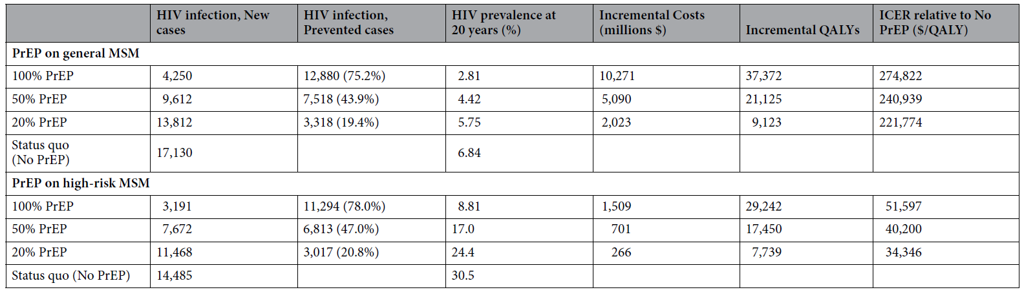
Cost-Effectiveness Analysis
PrEP for high-risk MSM can achieve cost-effectiveness.

Slide 26
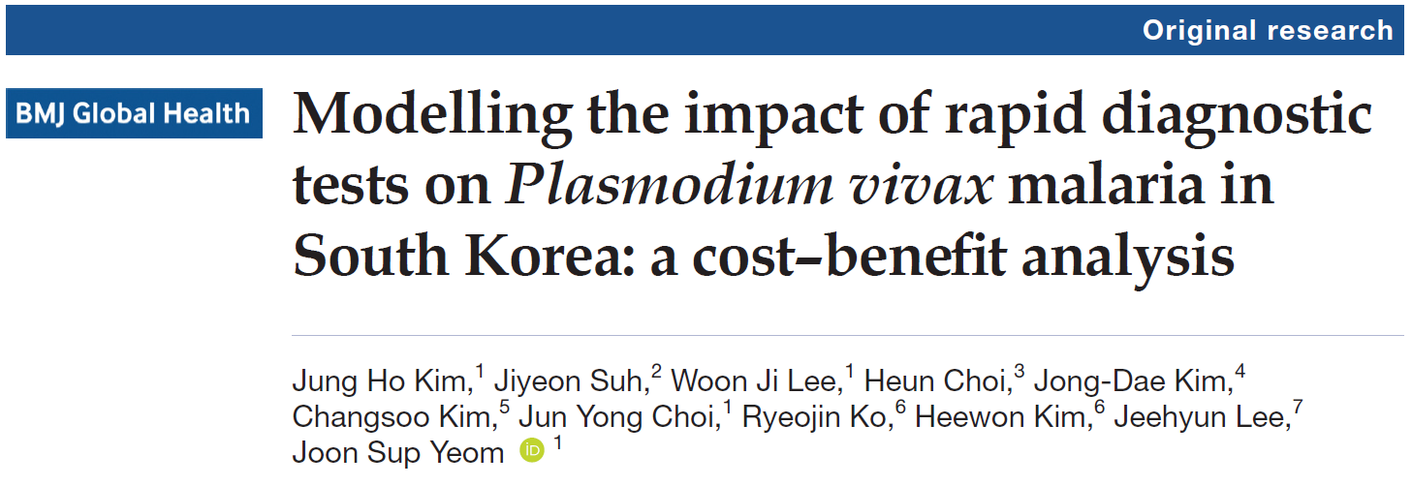
CBA of RDT for P. Vivax Malaria

Slide 27
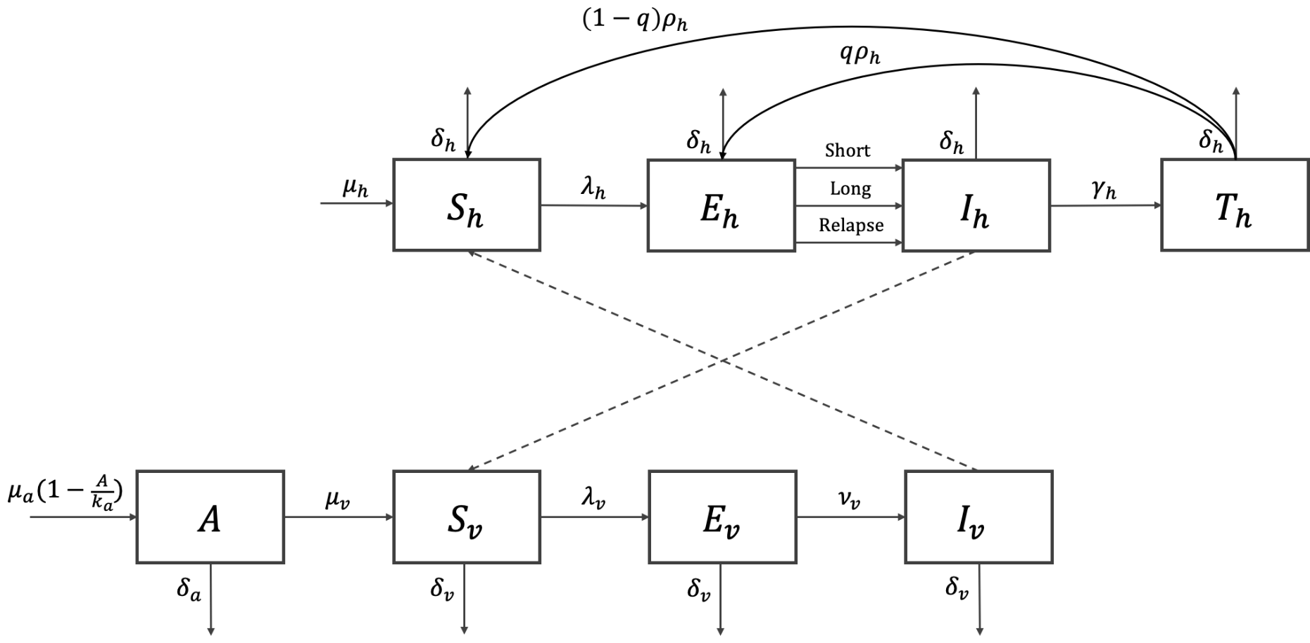
P. Vivax Malaria Transmission Model

Slide 28
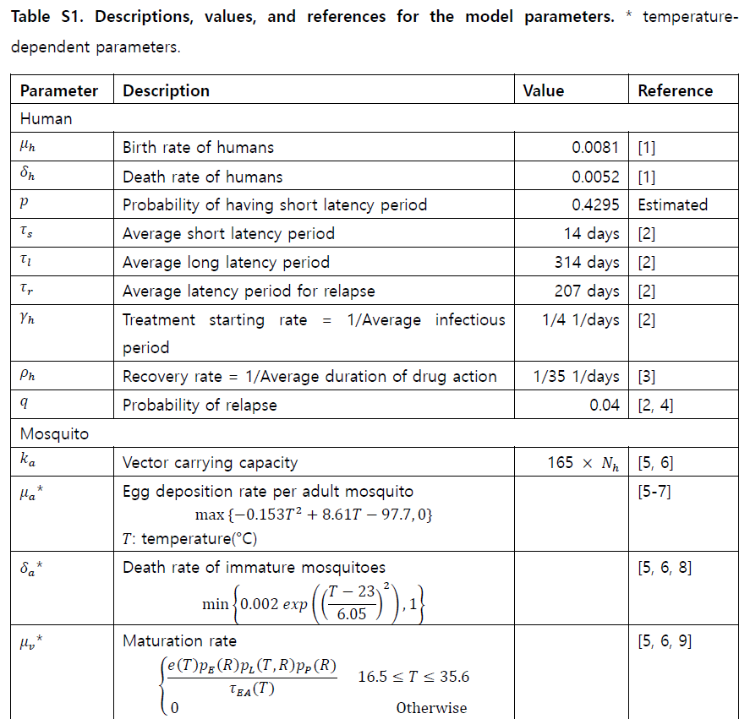
Model Parameters

Slide 29
Model Calibration

Slide 30
Diagnostic Interventions
Intervention scenario
Diagnosis | Infectious period
Microscopy only | 4 days
Microscopy + RDT | 3.5 days
Cost and benefit ($)
 | Costs | Benefits
Microscopy only | 11.72 | 0
Microscopy + RDT | 35.63 | 26.38

Slide 31
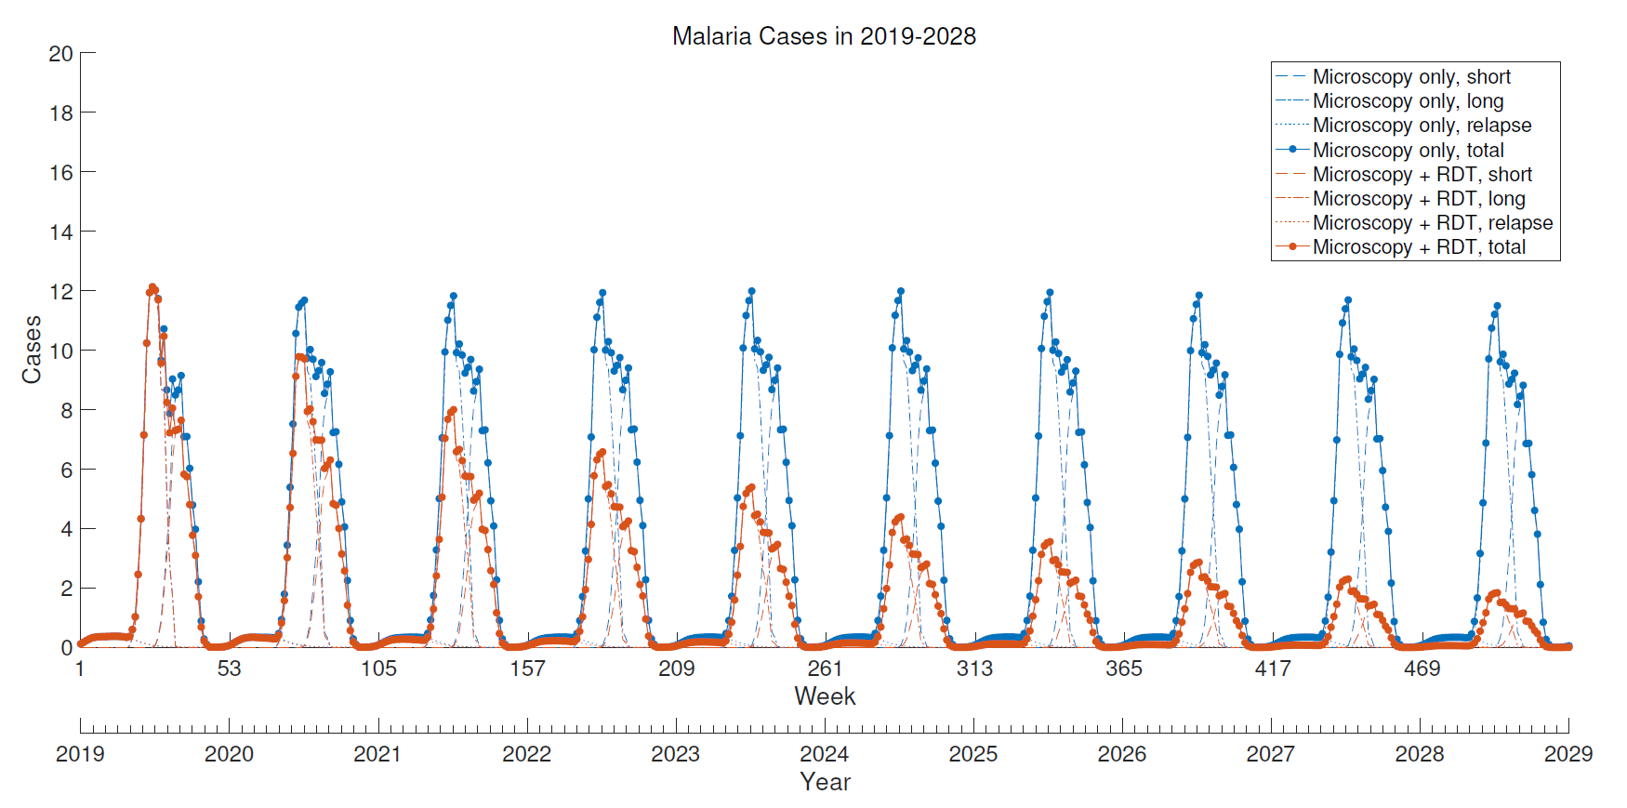
Prediction of Malaria Incidence

Slide 32
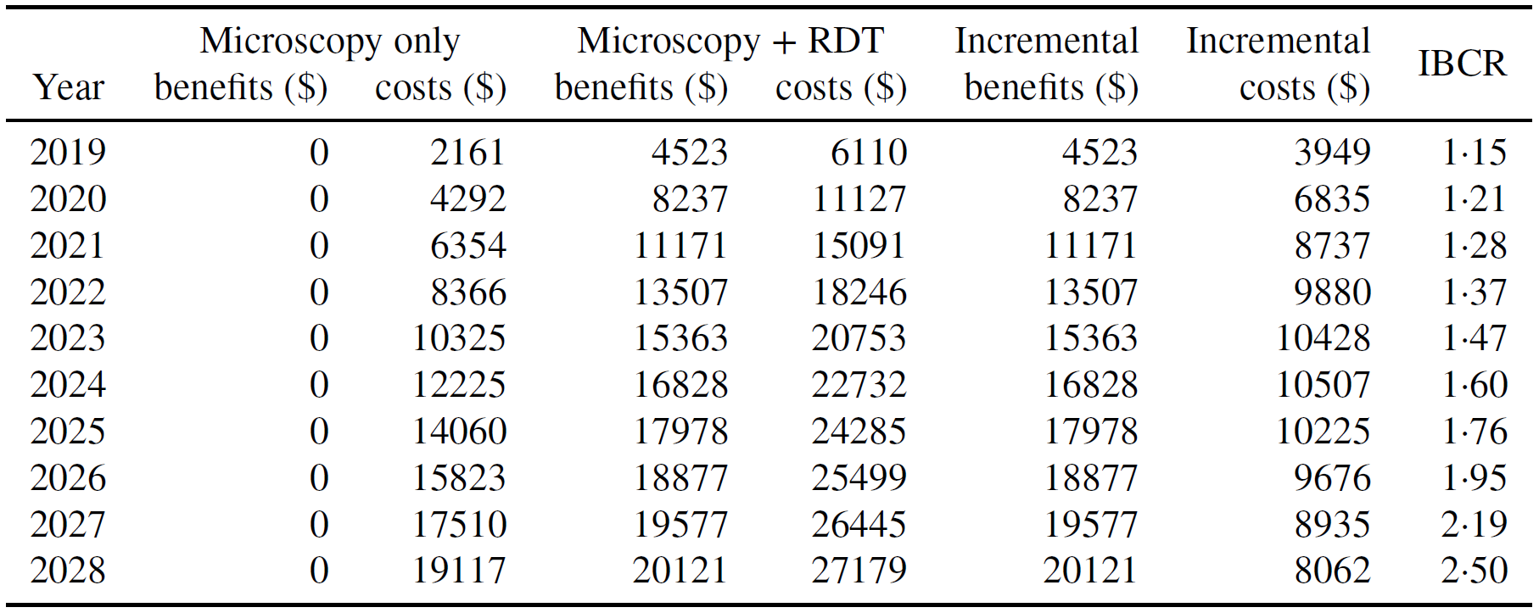
Cost-Benefit Analysis

Slide 33
References
Beutels P, Scuffham PA, MacIntyre CR. Funding of drugs: do vaccines warrant a different approach? Lancet Infect Dis 2008; 8:727.
Brisson M, Edmunds WJ. Economic evaluation of vaccination programs: the impact of herd immunity. Med Decis Making. 2003 Jan Feb;23(1):76 82.
Jit M, Brisson M. Modelling the Epidemiology of Infectious Diseases for Decision Analysis: A Primer. Pharmacoeconomics 2011; 29:371.
Jit M, White PG. Chapter 17: Economic analysis of interventions against infectious diseases. In: Oxford Specialist Handbook of Infectious Disease Epidemiology. OUP: Oxford, 2015.

Slide 34
Supplementary Information

Slide 35
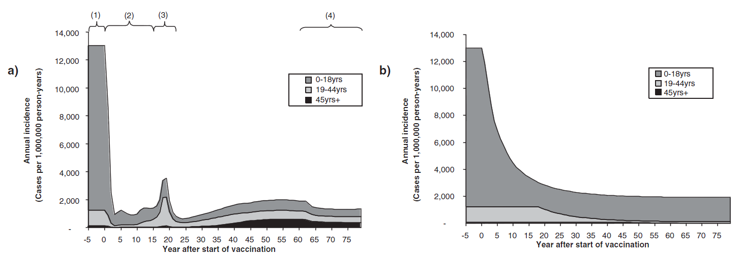
Static Model and Dynamic Model
Prevaccination and postvaccination dynamics of varicella infection. Estimated age-specific incidence of natural varicella after the introduction (at time 0) of infant vaccination using (a) a dynamic model and (b) a static model (80% coverage, perfect vaccine). The various epidemiological phases are 1) prevaccination, 2) period, 3) posthoneymoon epidemic, and 4) equilibrium.

